Slide 1
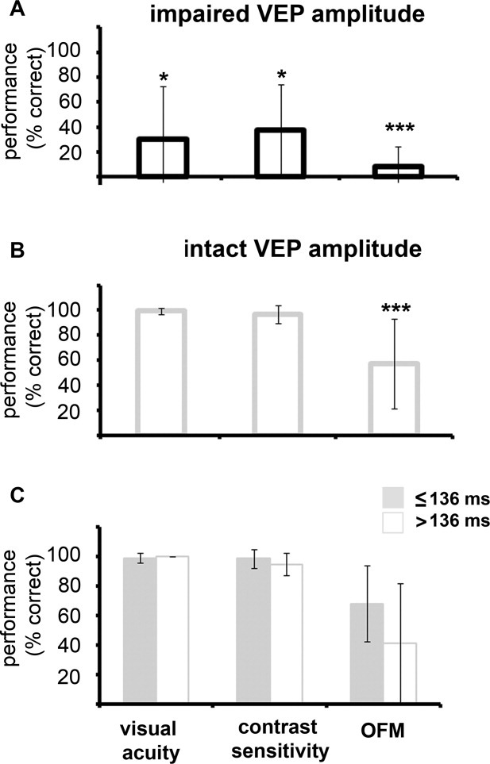
Demyelination affects temporal aspects of perception: An optic neuritis study
Annals of Neurology, Volume: 71, Issue: 4, Pages: 531-538, First published: 09 December 2011, DOI: (10.1002/ana.22692)
Notes:
Visual measurements as a function of visual evoked potential (VEP) amplitudes and latencies. Visual acuity, contrast sensitivity, and object from motion (OFM) levels in optic neuritis eyes with (A) impaired and (B) intact amplitudes (n = 5 and 16, respectively) are shown. (C) Performance levels for the different visual measurements for eyes with intact amplitudes are divided according to their VEP latencies (<136 milliseconds, n = 8; >136 milliseconds, n = 8; a threshold of 136 milliseconds was chosen because this was the median latency level among eyes with intact amplitudes). The data included for each patient were taken from the latest time point available. Asterisks denote significant reduction of AE performance as compared to the normal values, *p < 0.05; ***p < 0.001.
IF THIS IMAGE HAS BEEN PROVIDED BY OR IS OWNED BY A THIRD PARTY, AS INDICATED IN THE CAPTION LINE, THEN FURTHER PERMISSION MAY BE NEEDED BEFORE ANY FURTHER USE. PLEASE CONTACT WILEY'S PERMISSIONS DEPARTMENT ON PERMISSIONS@WILEY.COM OR USE THE RIGHTSLINK SERVICE BY CLICKING ON THE 'REQUEST PERMISSIONS' LINK ACCOMPANYING THIS ARTICLE. WILEY OR AUTHOR OWNED IMAGES MAY BE USED FOR NON-COMMERCIAL PURPOSES, SUBJECT TO PROPER CITATION OF THE ARTICLE, AUTHOR, AND PUBLISHER.

